Slide 1
SQL Database
Triggers

Slide 2
Review: Create ERD (from last lesson)
Remember about process of
1NF - 3NF

Slide 3
SQL Triggers
Triggers are database operations that are automatically performed when a specified database event occurs.
Types of triggers:
INSERT
UPDATE
DELETE
Benefits :
Faster application development. Because the database stores triggers, you do not have to code the trigger actions into each database application.
Easier maintenance.
Improve performance in client/server environment.
Cons:
Triggers can be difficult to troubleshoot because they execute automatically in the database.
Triggers can add complexity to your database design and impact database performance.

Slide 4
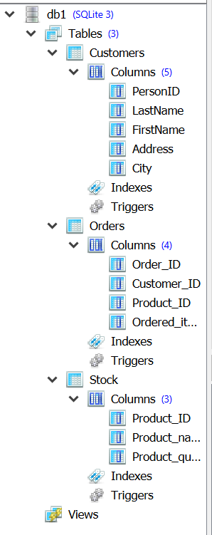
Online shop database - example Customers, Orders and Stock

Slide 5
Insert data to the Customer and Stock tables
insert into customers values(1,"Harorld","Jayne","34 Hill Road",Southampton)
insert into customers values(2,"Jackobs","Sam","34 Greg Road","Southampton")
insert into stock values(101,“Strawberry",100);
insert into stock values(102,“Apple",100);
insert into stock values(103,"Pineapple",100);

Slide 6
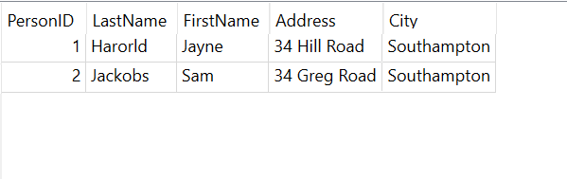
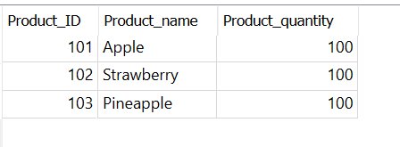


Customers
Stock
Orders
insert into orders values(10001, 1, 101, 5);

Slide 7
We need to create a trigger:
To calculate and update items left in the stock after an order

Slide 8

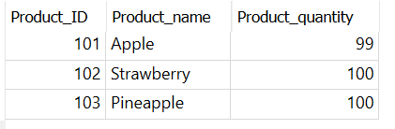
Creating insert Trigger to update Stock data
insert into orders values(100002,1,101,111)
CREATE TRIGGER Trigger1
AFTER INSERT
ON orders
BEGIN
UPDATE stock
SET product_quantity = 99
WHERE product_Id = 101;
END
Select * from orders
Select * from stock
This trigger updated the stock data (product_quantity but not correct calculation)

Slide 9
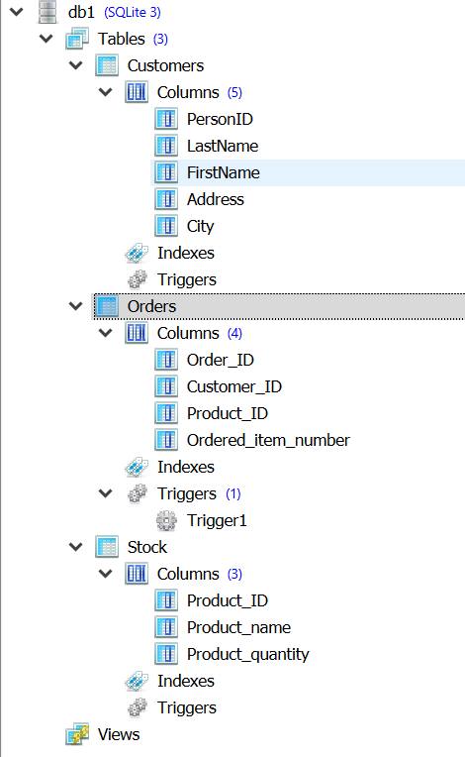
Trigger1

Slide 10
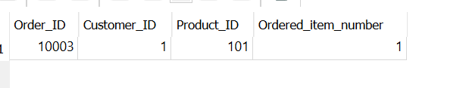
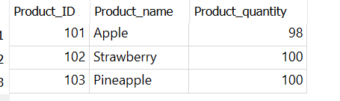
Creating insert Trigger to update Stock data (using New object)
insert into orders values(10003,1,101,1)
select * from orders
DROP TRIGGER Trigger1;
CREATE TRIGGER Trigger1
AFTER INSERT
ON orders
BEGIN
UPDATE stock
SET product_quantity = (product_quantity - new.Ordered_item_number)
WHERE product_Id = new.Product_ID;
END;
This trigger updated the stock data (product_quantity and correct calculation)

Slide 11
What will happen if “Product_quantity” in stock less than “Ordered_item_number”
-2
100
Try :
SELECT IIF((select ordered_item_number from orders where product_ID=101)<(select Product_quantity from stock where product_id=101), 'Yes', 'No' ) message;

Slide 12
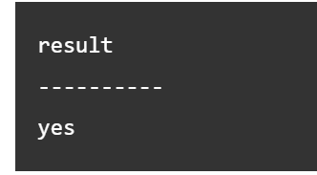
IIF statement
SELECT IIF(1 < 2, 'Yes', 'No' ) result;

Slide 13
Solution (create a trigger before insert on orders)
SELECT CASE WHEN (
SELECT Product_quantity FROM Stock WHERE
Product_Id = new.Product_Id) < new.Ordered_Item_Number
THEN RAISE(
ABORT, 'Not enough products in stock'
)
END;
*What will happen if “Product_quantity” in stock less than “Ordered_item_number”

Slide 14
Task 1:
Add extra table (order_cost)
Create an insert trigger on orders to update order_cost
OR
create an update trigger on orders to update order_cost

Slide 15
Reading and examples about SQL Triggers
https://www.w3resource.com/sqlite/sqlite-triggers.php#MTAI

